Slide 1
Robots and C&E 2019
Collaborative Robot Seminar

Slide 2
Where did collaborative robots come from? What was the first one?

Slide 3
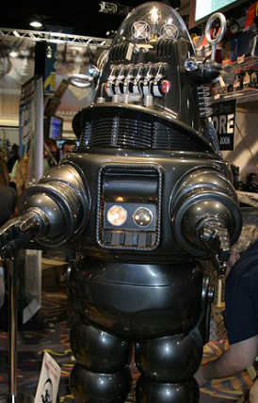

Robby the robot 1956
“the forbidden planet”
Movie

Slide 4
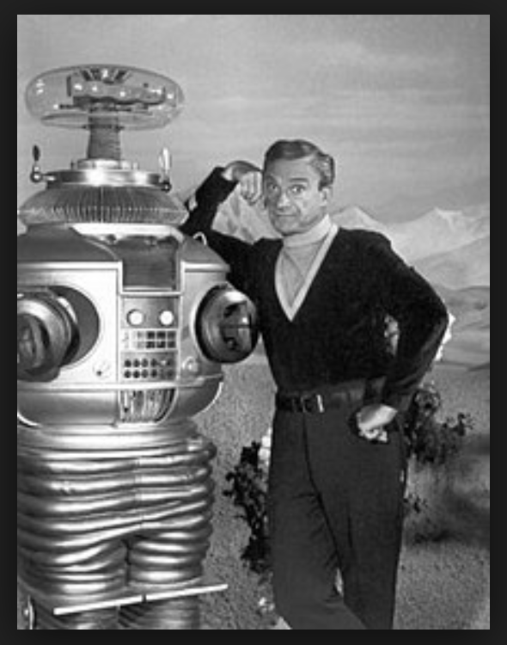
First friendly cobot to appear on TV:
Name: Robot B9
Lost in Space 1965
“Danger Will Robinson”

Slide 5
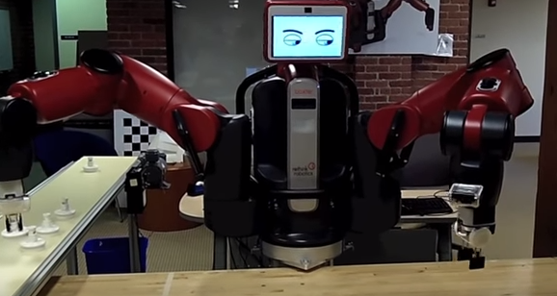
Rethink Robotics (formerly Heartland Robotics, Inc.) was a robotics company co-founded by Rodney Brooks and Ann Whittaker in 2008. Rethink robotics closed its doors on October 3, 2018
Baxter – 1st Industrial Cobot?

Slide 6
Specific use robots (made for only one task)
https://youtu.be/DLCaNKqVagY

Slide 7
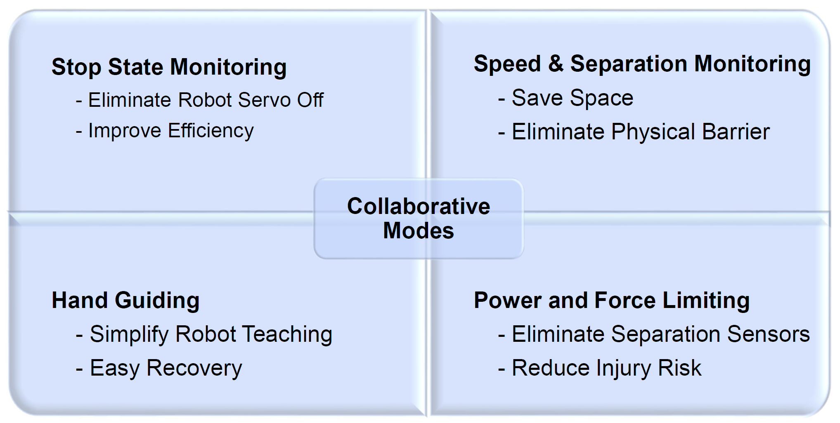

Slide 8
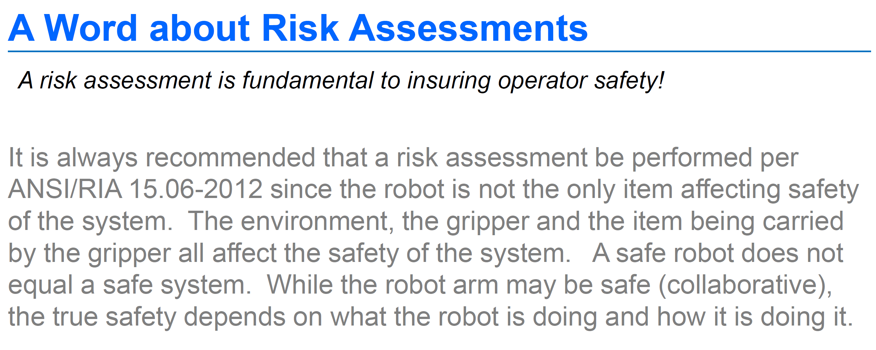
- Motoman presentation on cobots

Slide 9
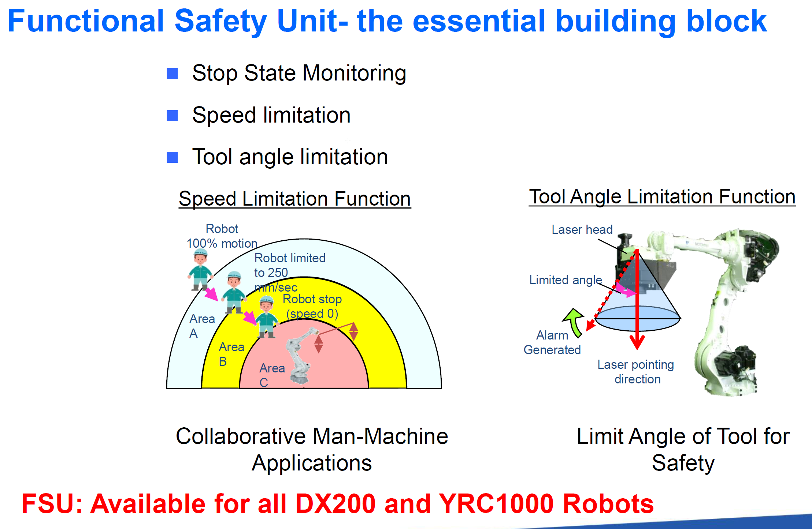

Slide 10
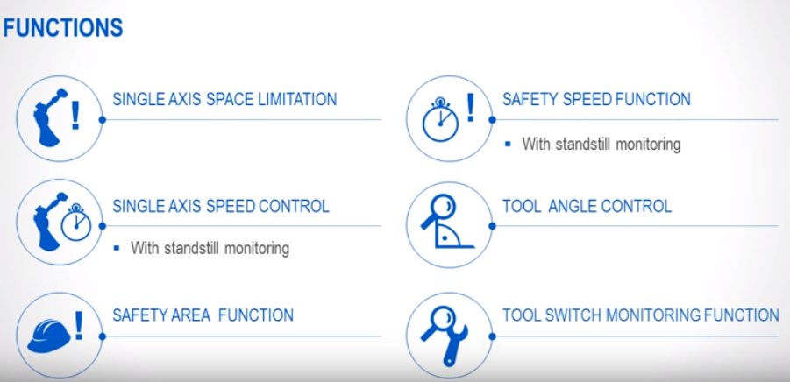
The FSU (Functional Safety Unit) is available on most Motoman robots, including the HC10

Slide 11
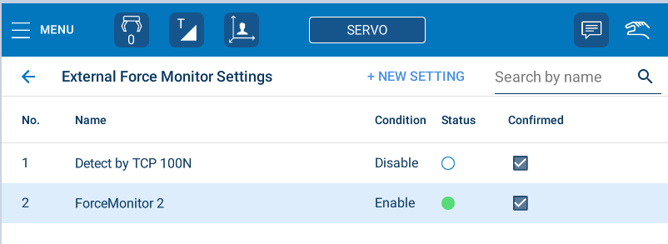
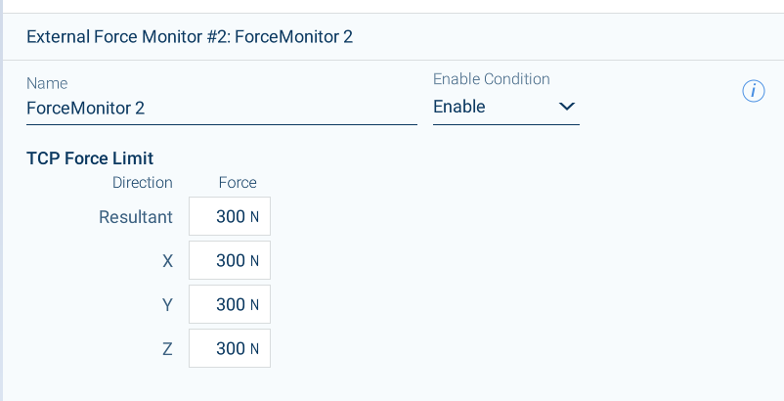

Slide 12
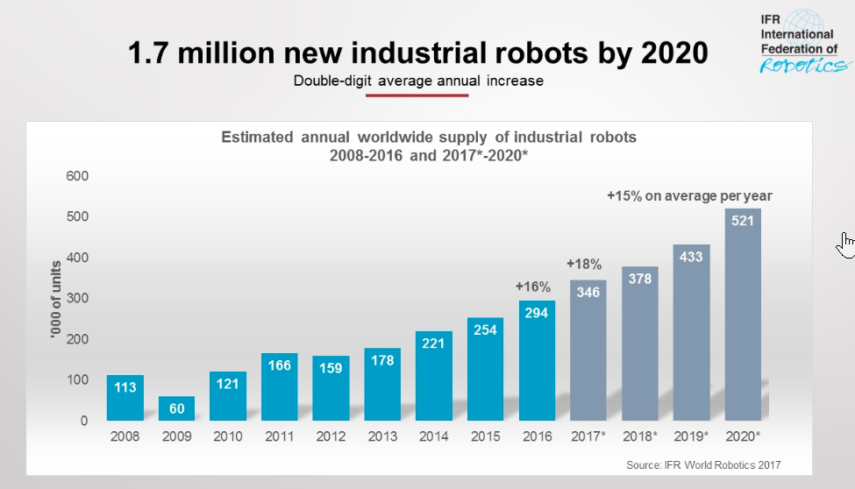

Slide 13
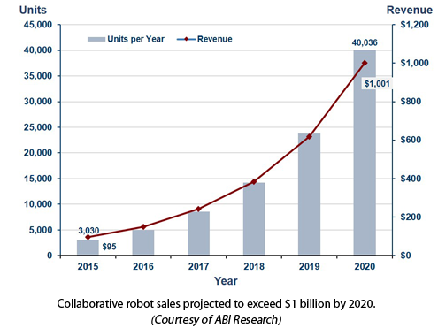

Slide 14
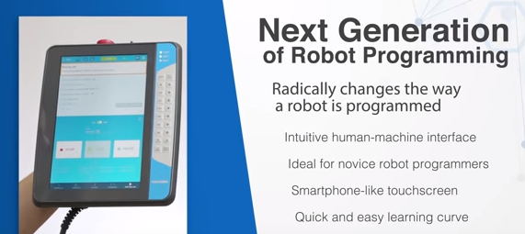
Smart Pendant

Slide 15
Videos on C&E’s youtube channel playlist = MOToman / hc10 / smart pendant
https://www.youtube.com/playlist?list=PLT-SbSZiQM2mKrnk8SjIc7VZ7cxCpnoPL
Creating a program with the Smart Pendant
Changing security levels
Changing PFL profiles
Hand Guiding Mode
Editing jobs and touching up points
And more… requests?

Slide 16
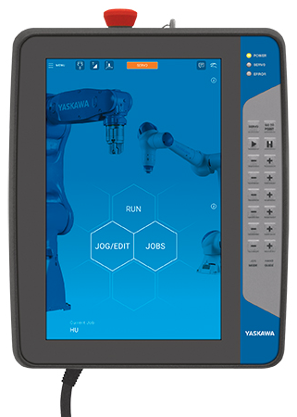
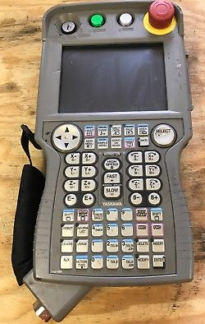


Slide 17
Software pendant
When you need to get to the functions that are currently not yet ported to the SmartPendant, you make an Ethernet connection to the controller (setting your pc to a known range of IP (192.168.1.XX) their default is .31) You then start the Smart Pendant software which can be downloaded to a USB drive attached to the SmartPendant.
…. YOUTUBE
Starting the software
The software pendant allows you all of the options that a standard pendant offers using the INFORM programming language.

Slide 18
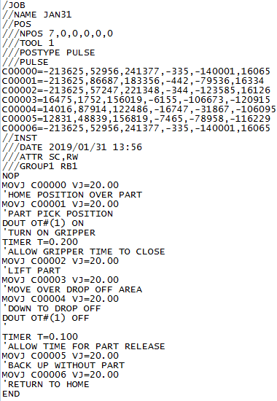
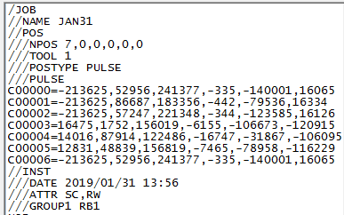
XXXX.JBI Files

Slide 19
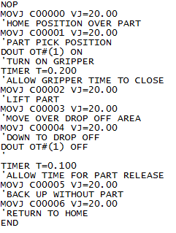
Start of file
Joint Move with a velocity of 20% speed
Comment line to describe action
Digital Output 1 turning ON
End of File

Slide 20
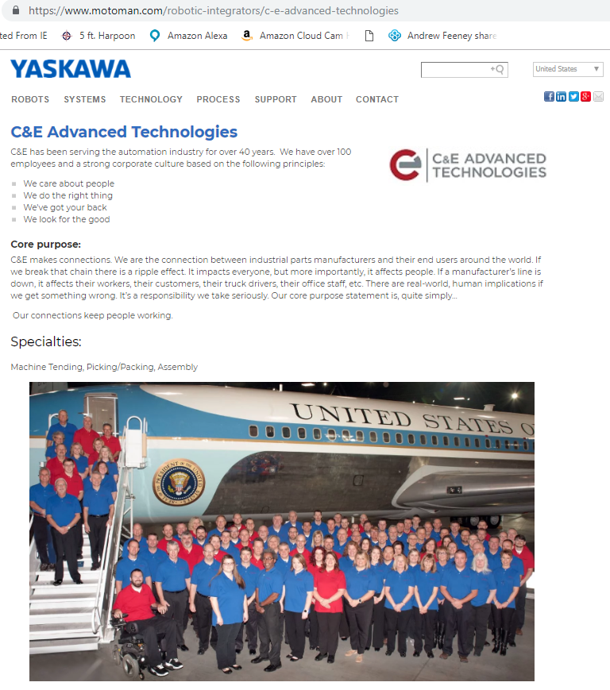

INTEGRATORS & DISTRIBUTORS

Slide 21
AGV vs AMR
AGV – Automated Guided Vehicle - (AGV) is a mobile robot that follows markers or wires in the floor, or uses vision, magnets, or lasers for navigation. They are most often used in industrial applications to move materials around a manufacturing facility or warehouse.
AMR – Autonomous Mobile Robot - An autonomous robot is a robot that performs behaviors or tasks with a high degree of autonomy.

Slide 22
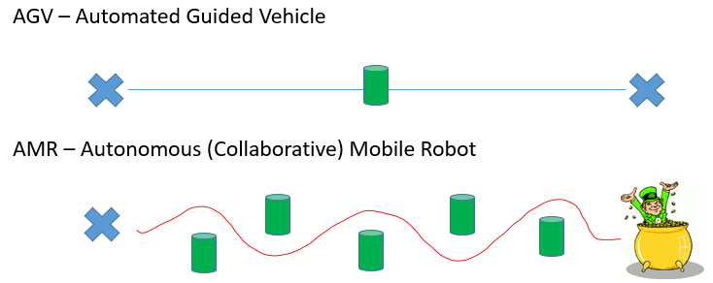

Slide 23
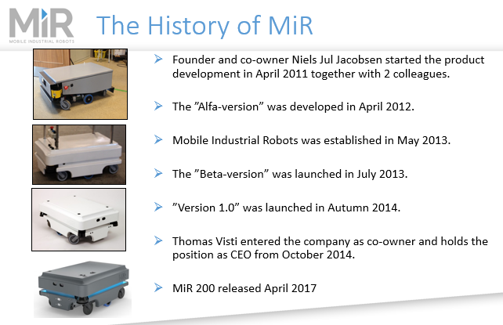
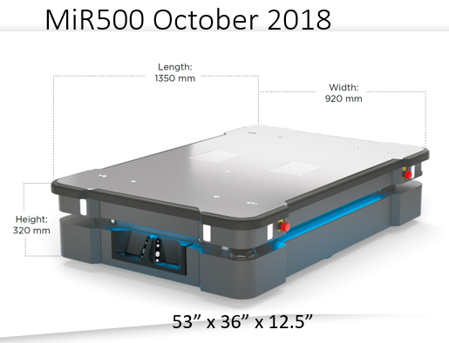

Slide 24
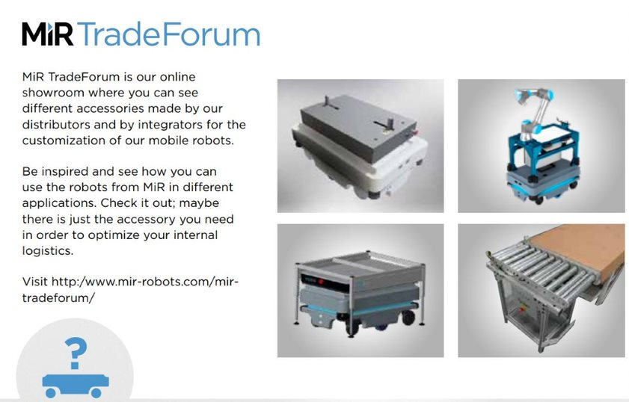

Slide 25
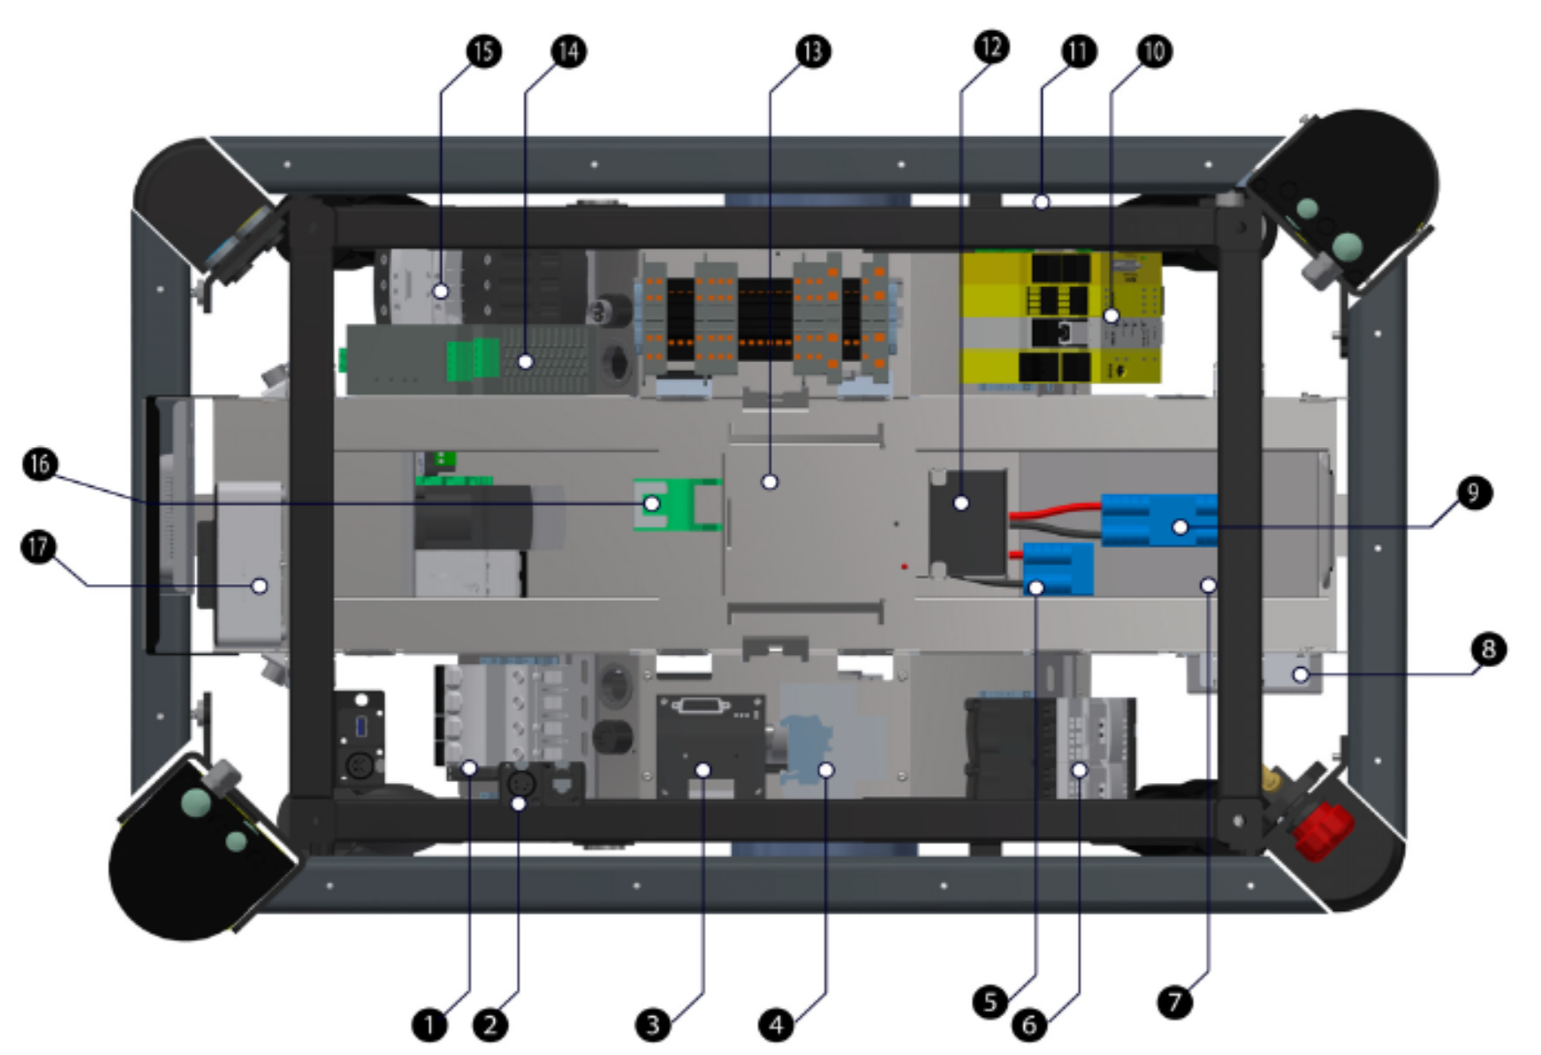

Slide 26
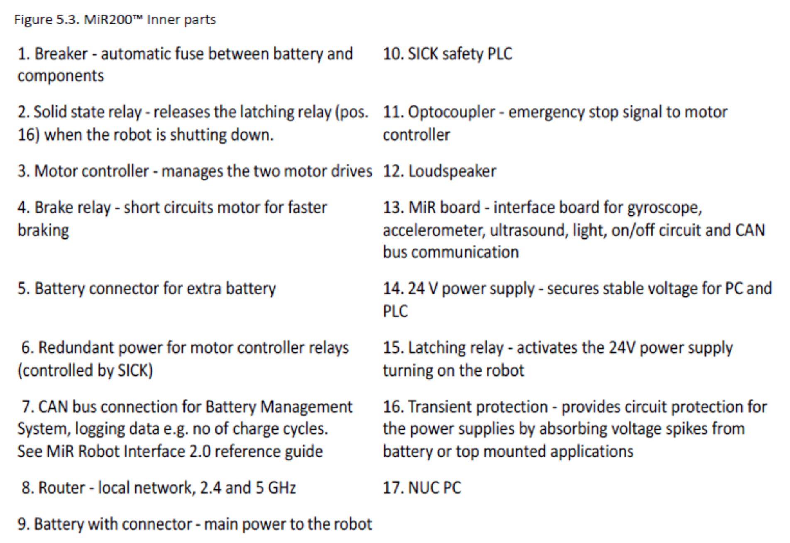

Slide 27
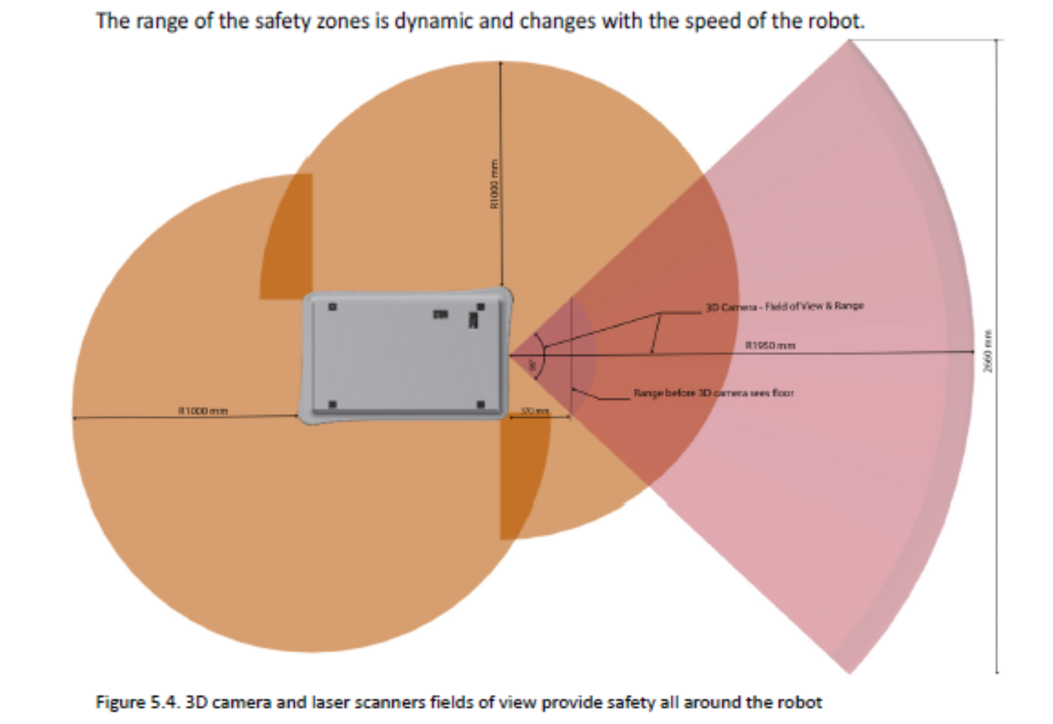
MiR LIdar scanners and 3D camera
(Intel Realsense)

Slide 28
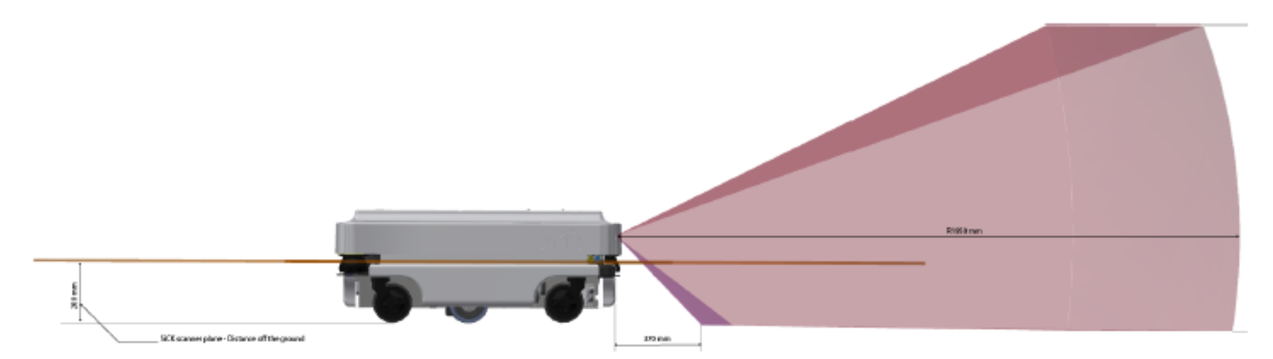
Objects need to be 2” tall or taller to be detected by the 3d camera on the front

Slide 29
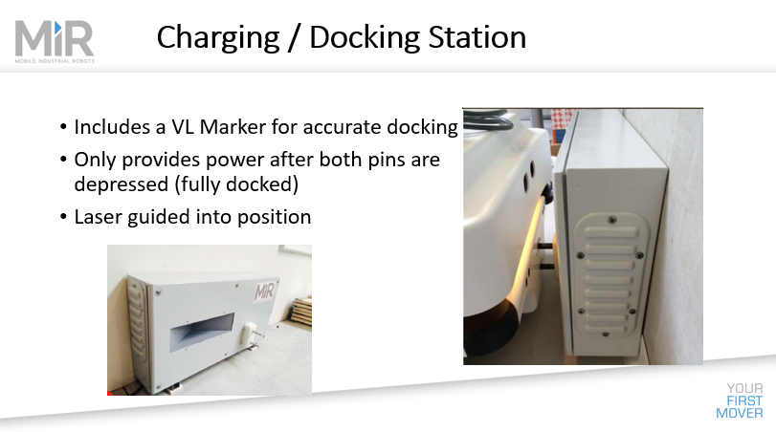

Slide 30
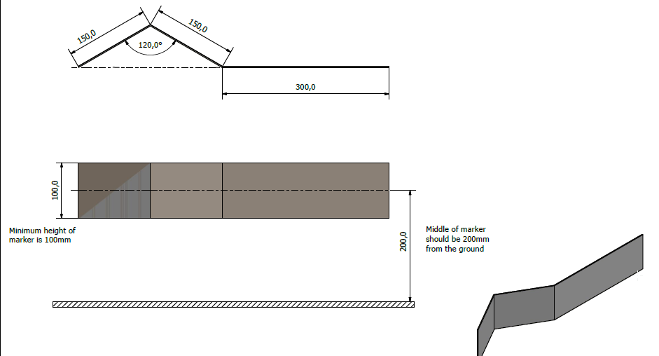

Slide 31
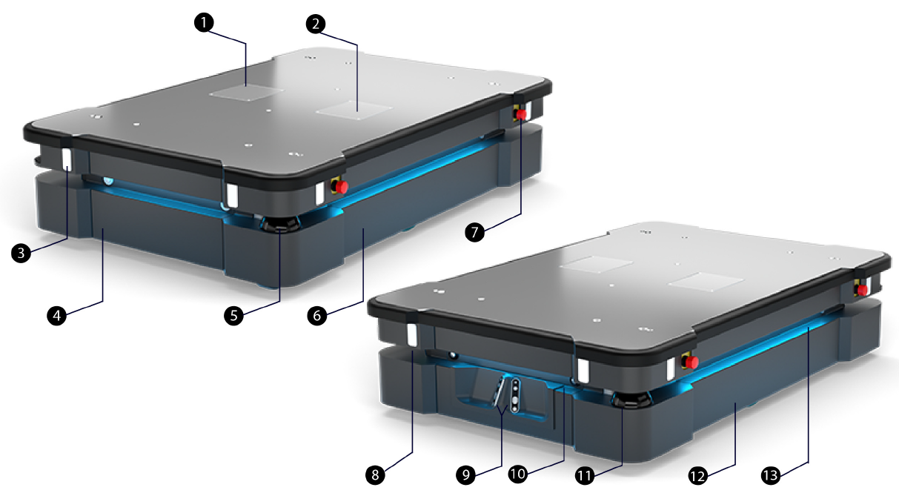

Slide 32
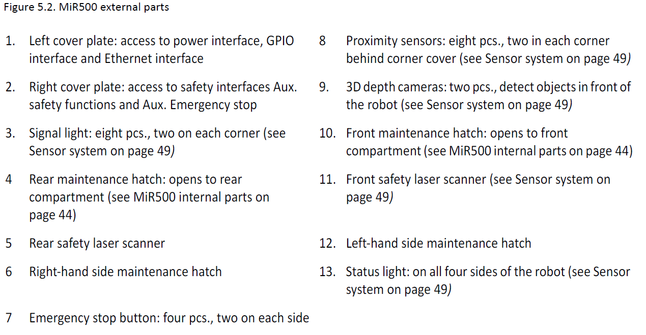

Slide 33
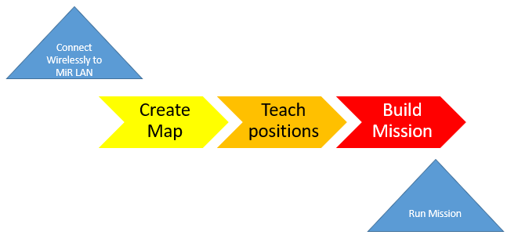
The steps

Slide 34
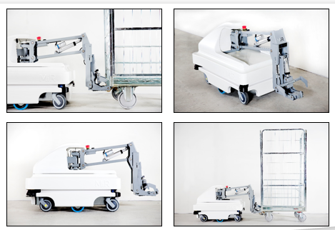
Videos overview pull a cart
500 w/pallet

Slide 35
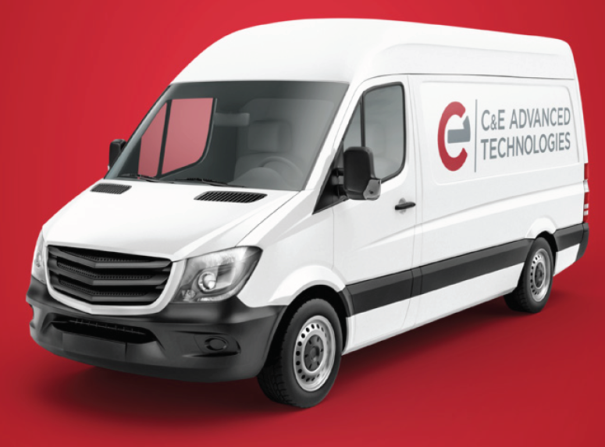
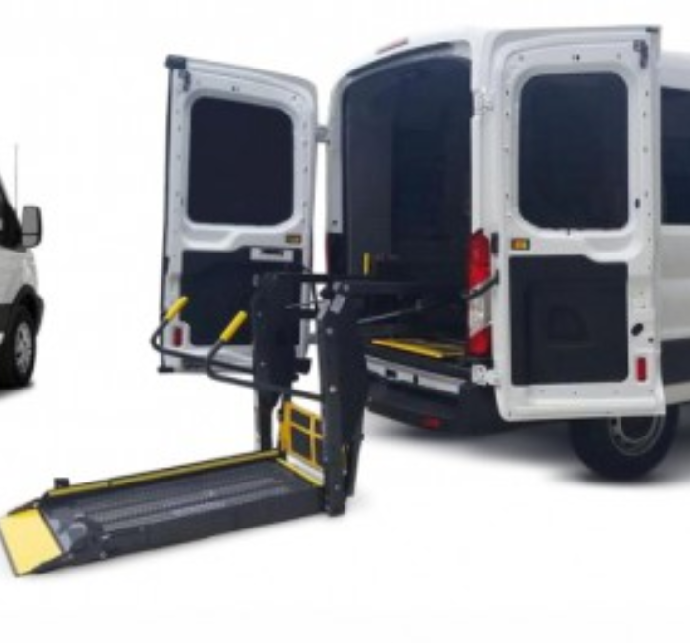
Getting the equipment around

Slide 36
Demos
I will start by running through a demo of the MiR200
  Create a Map
  Edit the Map
  Create positions
  Create and run a mission
Then we will change to the HC10DT
Hands On for anyone who wants to stick around

